Slide 1
“SJUber”
Chris Finan, Ryan Hassell, Erin Zahner

Slide 2
Overview
Purpose
Goals vs. Achievements
Main Implementation
Login Page
Registration Page
Main Page
View Trip History
Request a Ride
View Shuttle Schedules
Driver Tools

Slide 3


Purpose
Provide an efficient way for students to request rides from public safety
Function similar to Uber/Lyft
Request rides directly from phone
Introduce ETA feature for public safety
Provide shuttle tracking and shuttle schedules
+

Slide 4
Goals vs. Achievements
Goals
Achievements
Request rides
Have ETA
Track driver
See shuttle schedule
Track shuttle
Request Rides
Track Driver
See shuttle schedule
Track shuttle

Slide 5
Main Implementation
Back end:
Python (Pycharm)
SQL (PostgreSQL)
Front end:
Flutter/Dart (IntelliJ)

Slide 6
Login Page
You can log in with your SJU ID number or choose to create an account

Slide 7
Registration Page
At the bottom of this page you can select your user type to be “student” or “driver”
Clicking register will automatically log you in

Slide 8
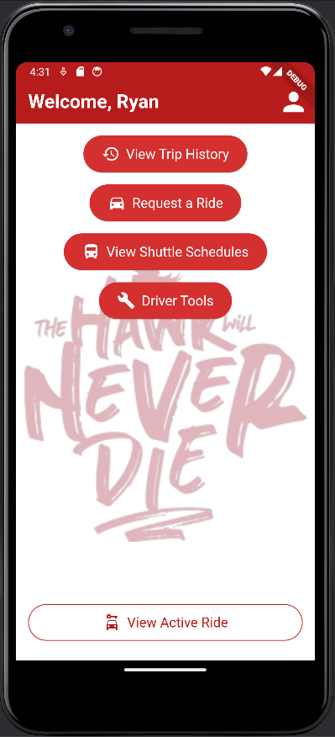
Main Page
The “Driver Tools” button only appears when the user type = driver

Slide 9
Request a Ride
Uses the Google Maps API to select start and end locations
Can type in named locations for convenience

Slide 10
View Trip History
Students or drivers may view the previous trips that they have been a part of

Slide 11
Shuttle Schedules
Uses the information from SJU’s website to display the shuttle schedule and uses the location tracking within the app to track the shuttle

Slide 12
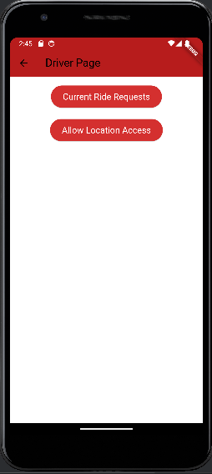
Driver Tools
Only drivers have access to this page
Current ride requests allows the driver to pick up unassigned rides
Allow location access gives location permissions to the app

